Slide 1
Chapters Autopilot & vision and OA
Shady Ammar

Slide 2
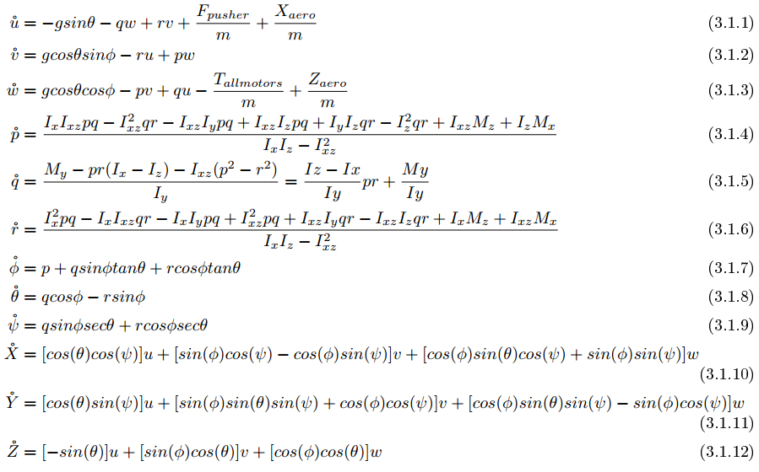
Nonlinear mathematical model

Slide 3
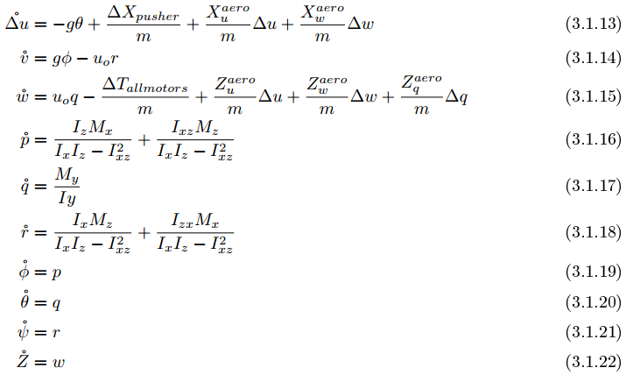
Quad-plane phase Linear model
Steady-state : all rates = 0 , φ = θ = 0 , p=q=r=0 , α =0

Slide 4
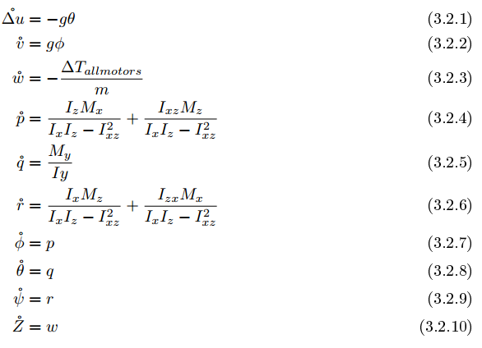
Quad-copter phase Linear model

Slide 5
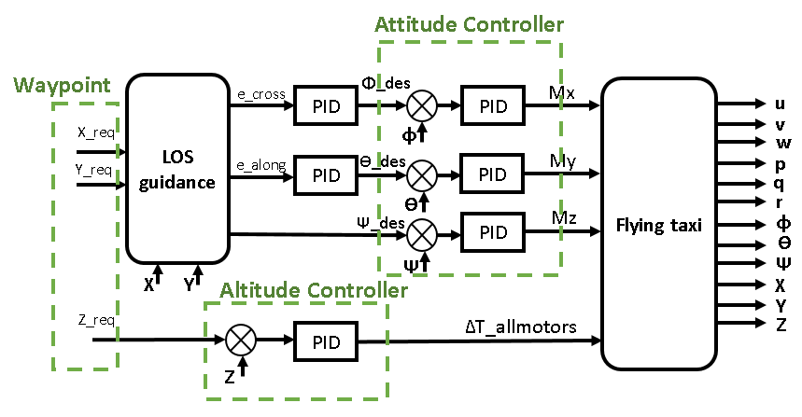
Quad-copter phase Autopilot

Slide 6
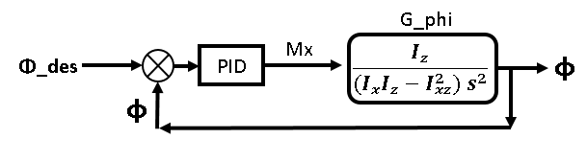
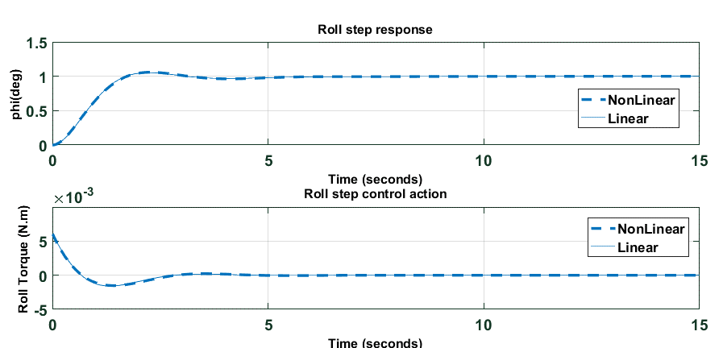
Attitude controller: Roll Controller
1 deg step response & control action

Slide 7
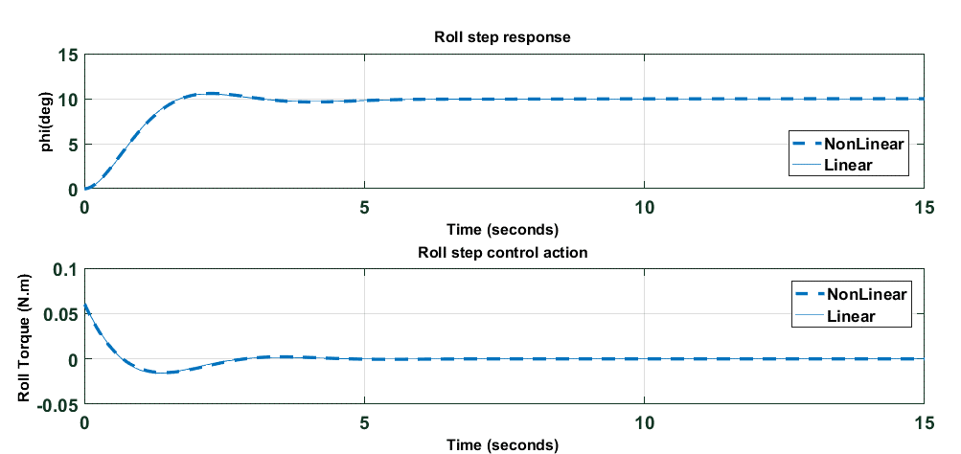
10 deg step response & control action

Slide 8
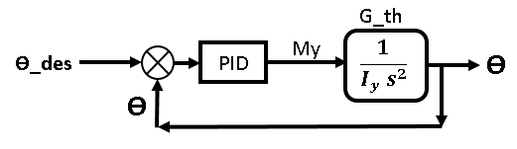
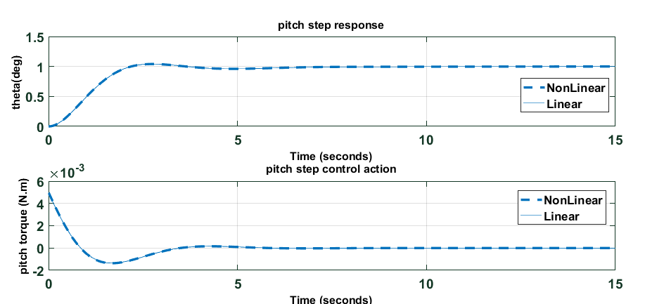
Attitude controller: Pitch Controller
1 deg step response & control action

Slide 9
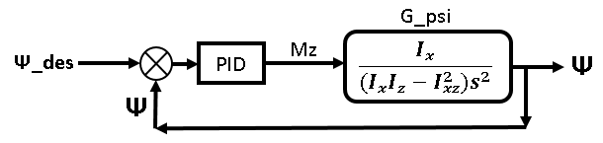
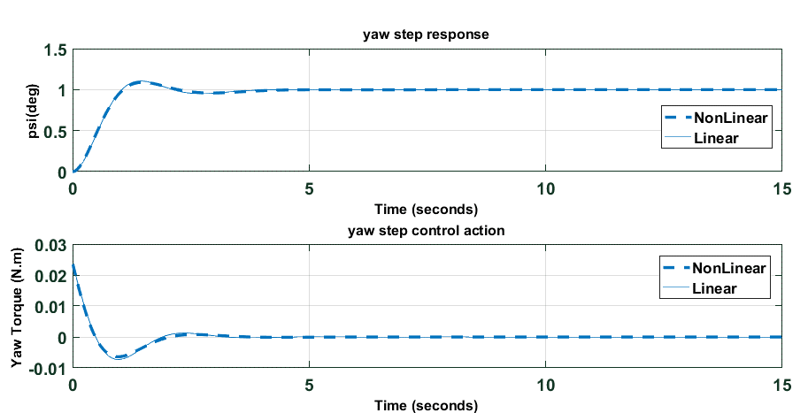
Attitude controller: Yaw Controller
10 deg step response & control action

Slide 10
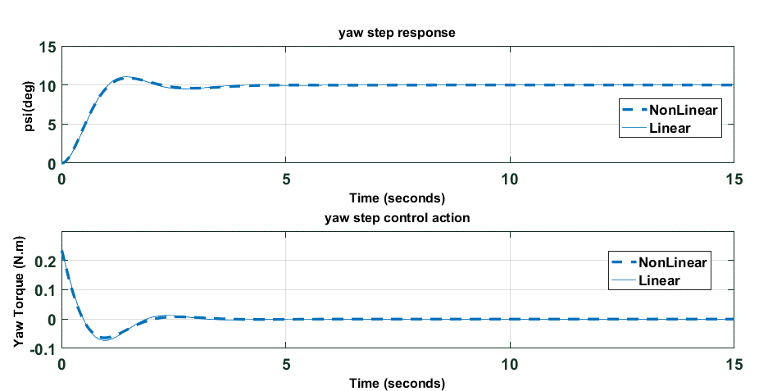
10 deg step response & control action

Slide 11
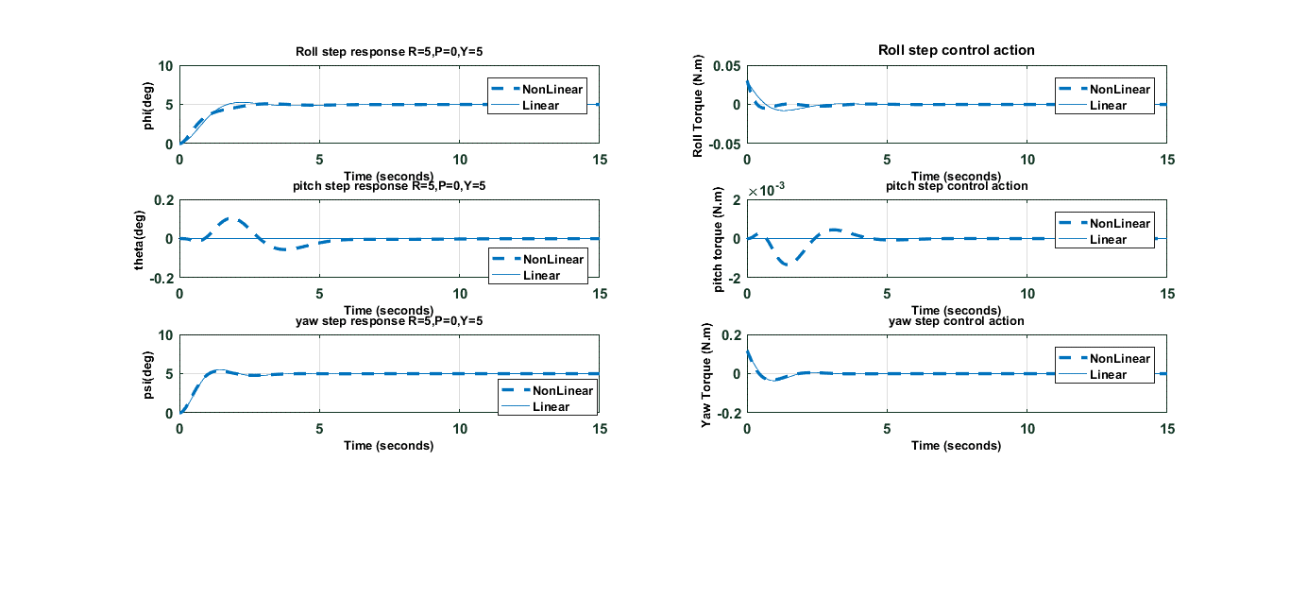
Roll , Pitch and Yaw Controllers together in action:
(Roll = 5deg / Pitch=0deg / Yaw = 5deg) step response & control action

Slide 12
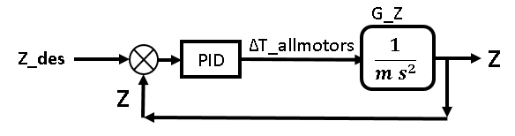
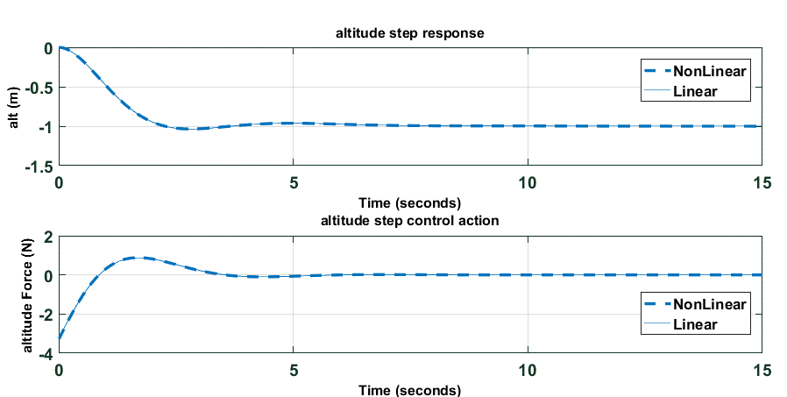
Altitude Controller
1 m (z = -1) step response & control action

Slide 13
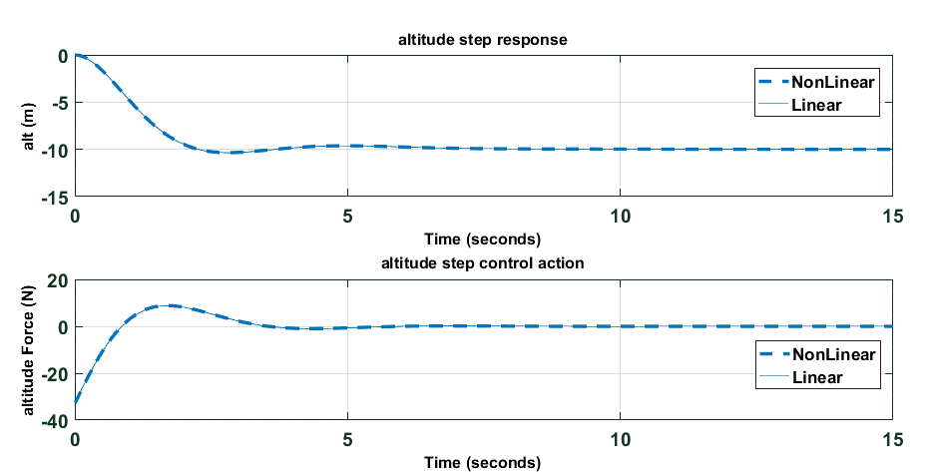
10 m (z = -10) step response & control action

Slide 14
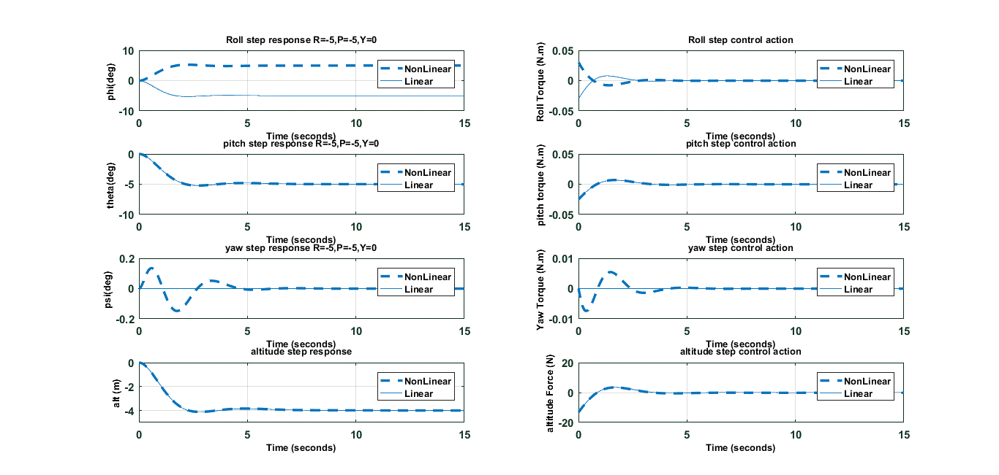
Attitude & Altitude controllers together in action
(Roll = 5deg / Pitch=-5deg / Yaw = 0deg / altitude = 4m) step response & control action

Slide 15
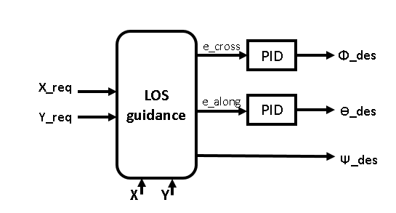
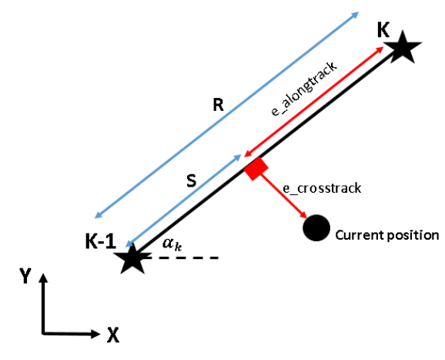
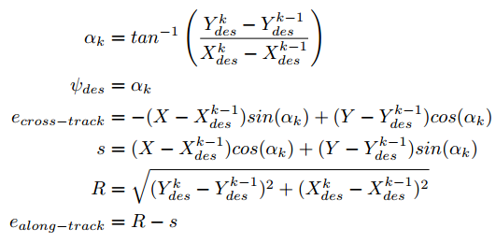
Line-of-sight (LOS) Guidance

Slide 16


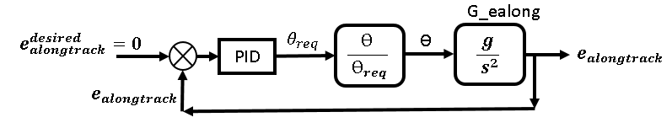


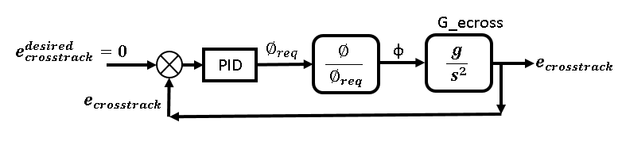

Slide 17
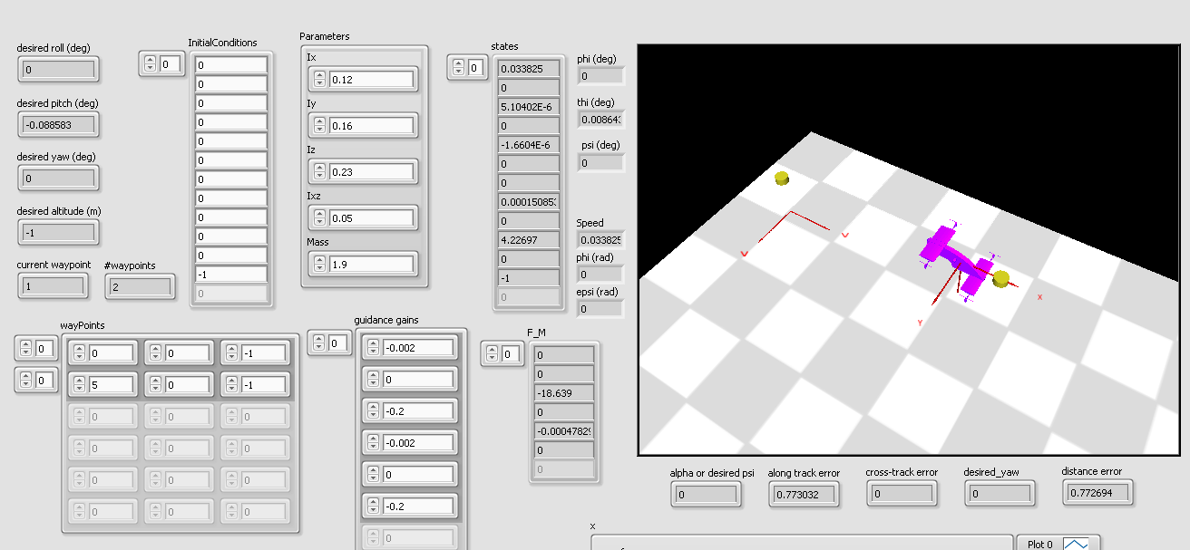

Slide 18
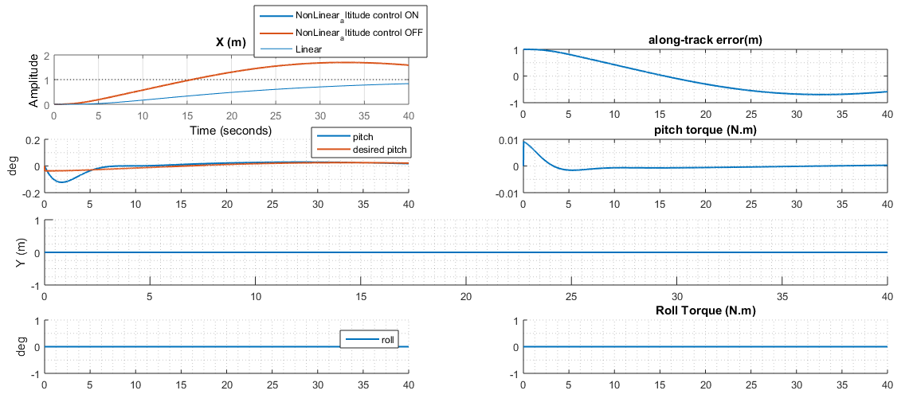
Oscillations with high settling time, we need to increase P , D

Slide 19
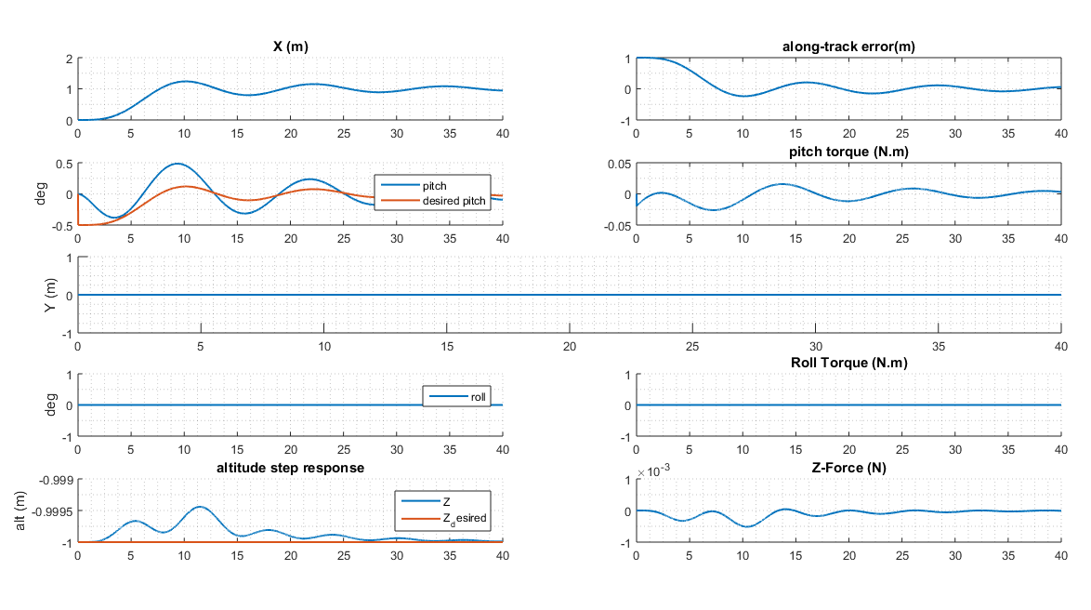

Slide 20
Simulation Video

Slide 21
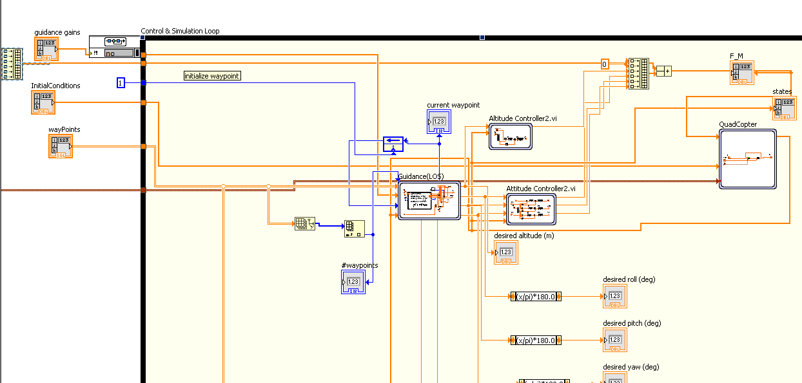
LabVIEW code

Slide 22
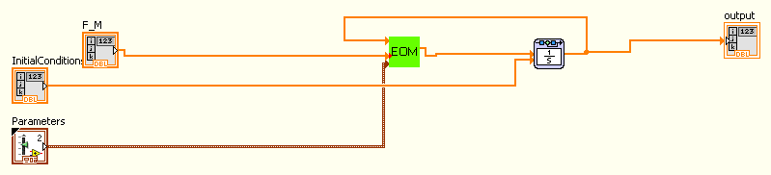
Quad-Copter phase nonlinear model

Slide 23
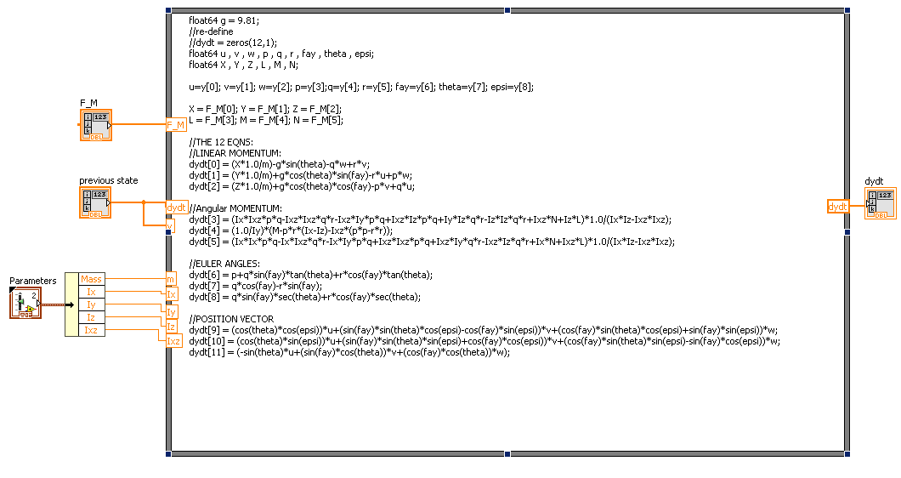

Slide 24
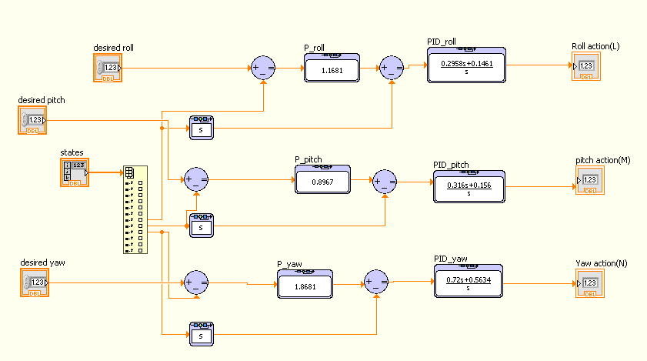
Attitude Controller

Slide 25
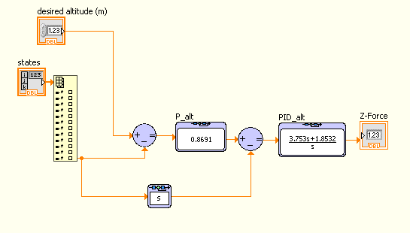
Altitude Controller

Slide 26
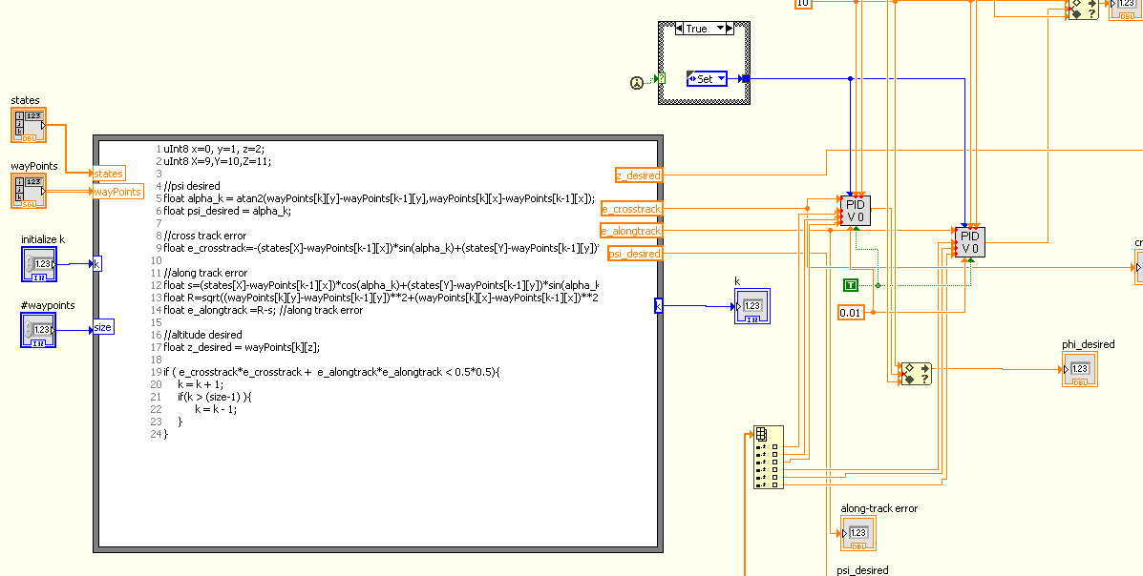
Guidance

Slide 27
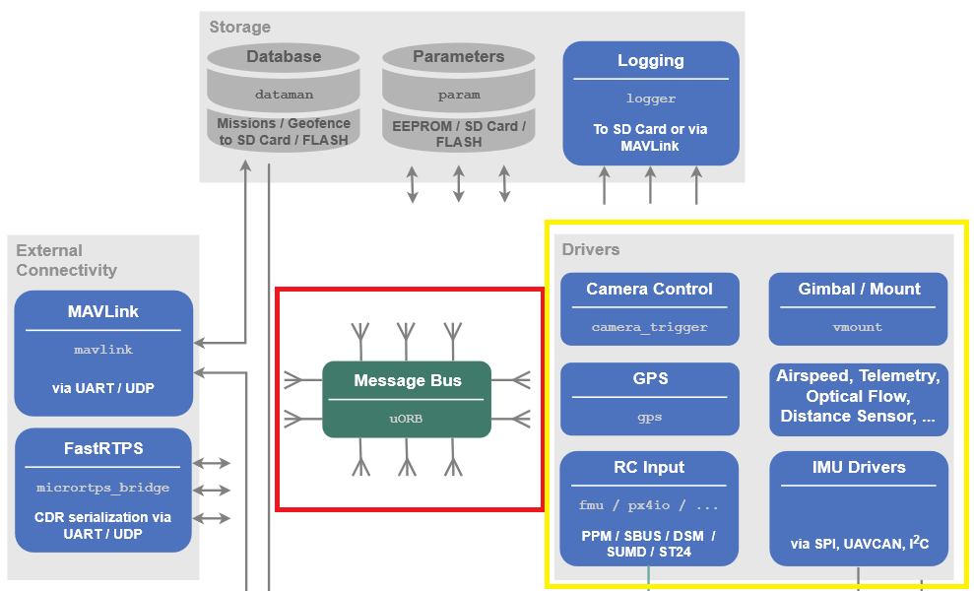
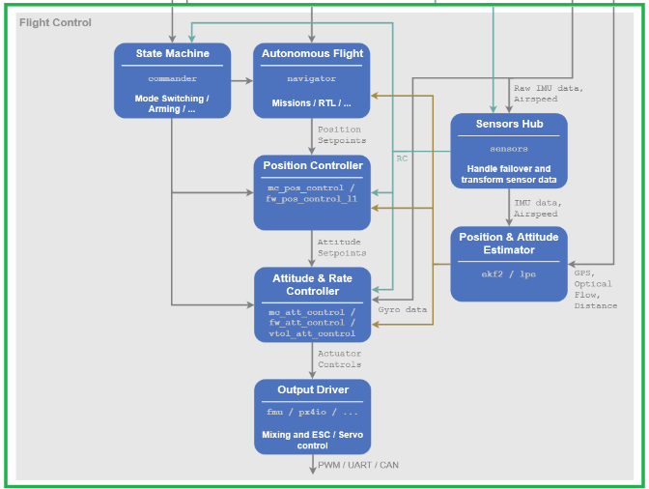
Commercial Autopilot
PIXHAWK is an autopilot hardware for academic, hobby and developer communitites and supports flight
stacks software like PX4 and ArduPilot.
Middleware
Flight stack

Slide 28
Middleware

Slide 29
Flight stack

Slide 30
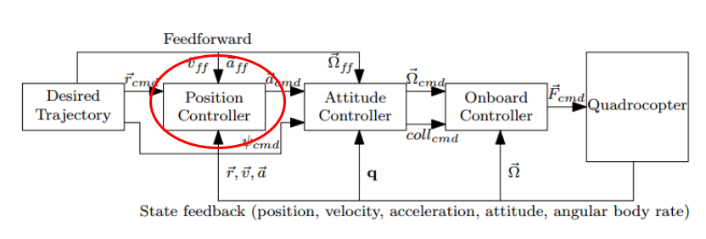
Position Controller

Slide 31
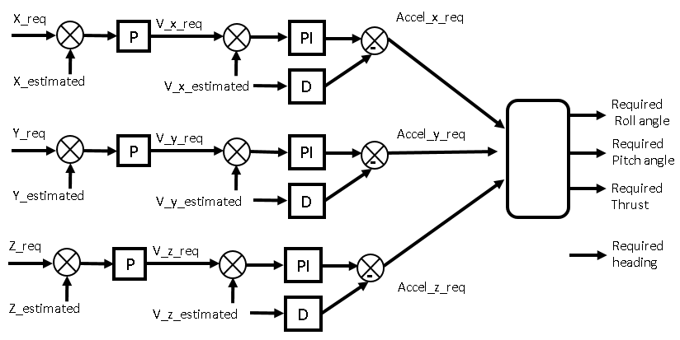
Position Controller

Slide 32
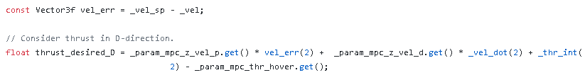

1st Loop : P
2st Loop : PID

Slide 33
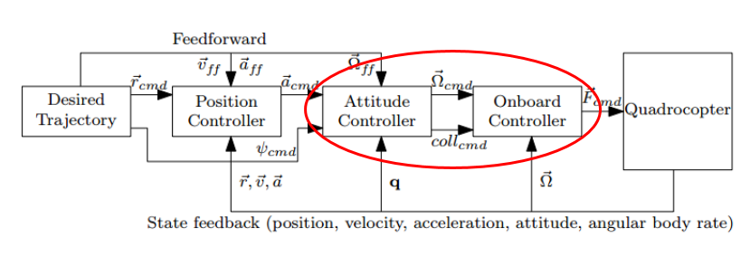
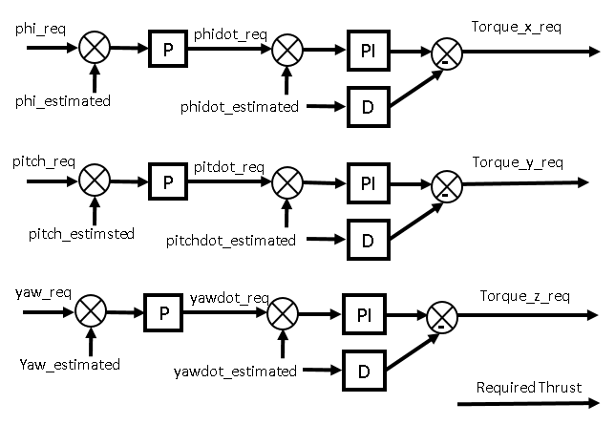
Attitude Controller

Slide 34
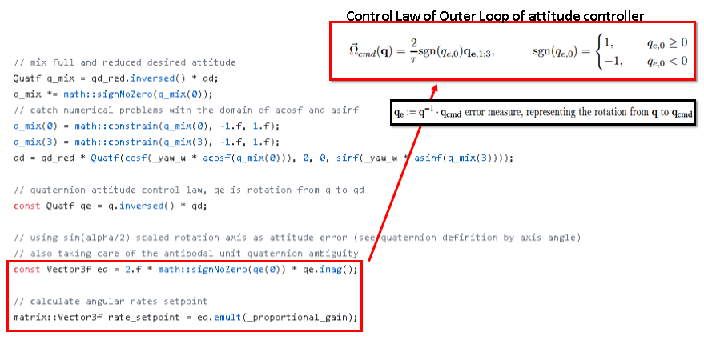
1st Loop : P

Slide 35
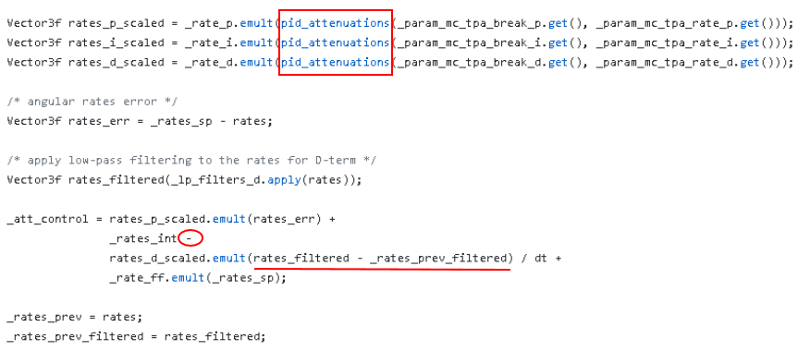
2st Loop : PID

Slide 36
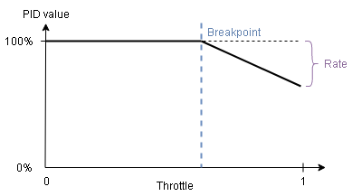
some measures to account for the nonlinear behavior of the motor in practice:
Thrust curve method | PID attenuation
Thrust = ( 1-factor ) PWM+ ( factor ) PWM^2 the factor is stored in “THR_MDL_FAC” parameter so we can change it to model our motors characteristics. | after some value of the throttle (for example: 70%) called “break-point”, we can attenuate the gains to decrease the control effort according to a parameter called “rate”. The break-point value is configured using “MC_TPA_BREAK_*” parameters , and the rate is configured using “MC_TPA_RATE_* ” parameters.

Slide 37
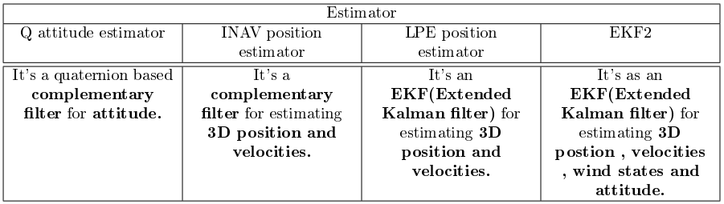
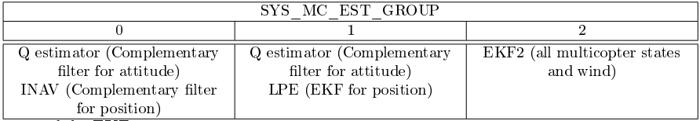
Estimators
In PX4 flightstack, there is 4 types of estimators are defined so we can choose the one that suits our application:

Slide 38
Logging
SD card | Log Streaming
The most ecient way for large data size is using SD card on the PIXHAWK where the data is logged. | The Log Streaming way, which sends the same logging data via MAVLink. The requirement is that the link(for example WiFi) provides at least 50 KB/s and only one client can request log streaming at the same time. The connection doesn't necessarily need to be reliable because the protocol can handle drops.

Slide 39
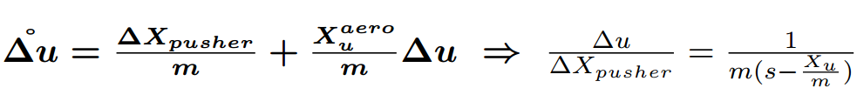
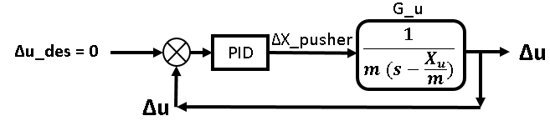
Quad-plane phase cruise controller

Slide 40
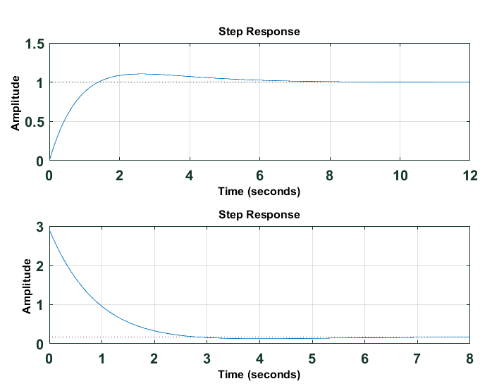
step response & control action

Slide 41
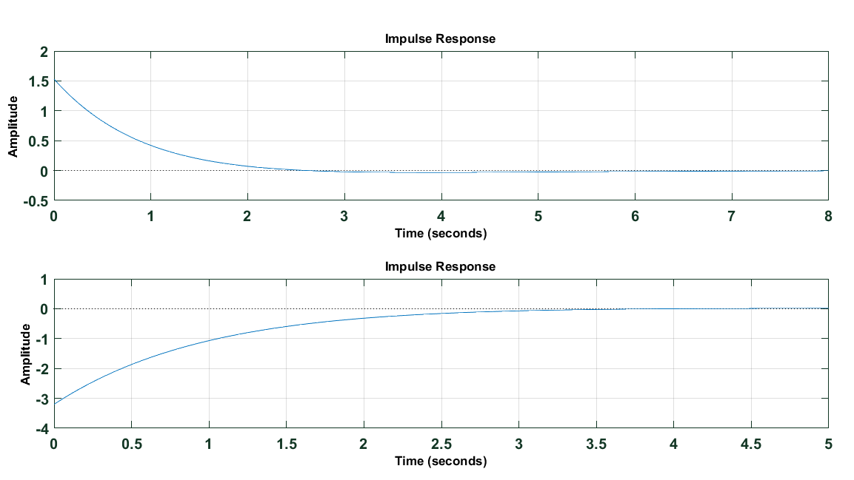
impulse response & control action

Slide 42

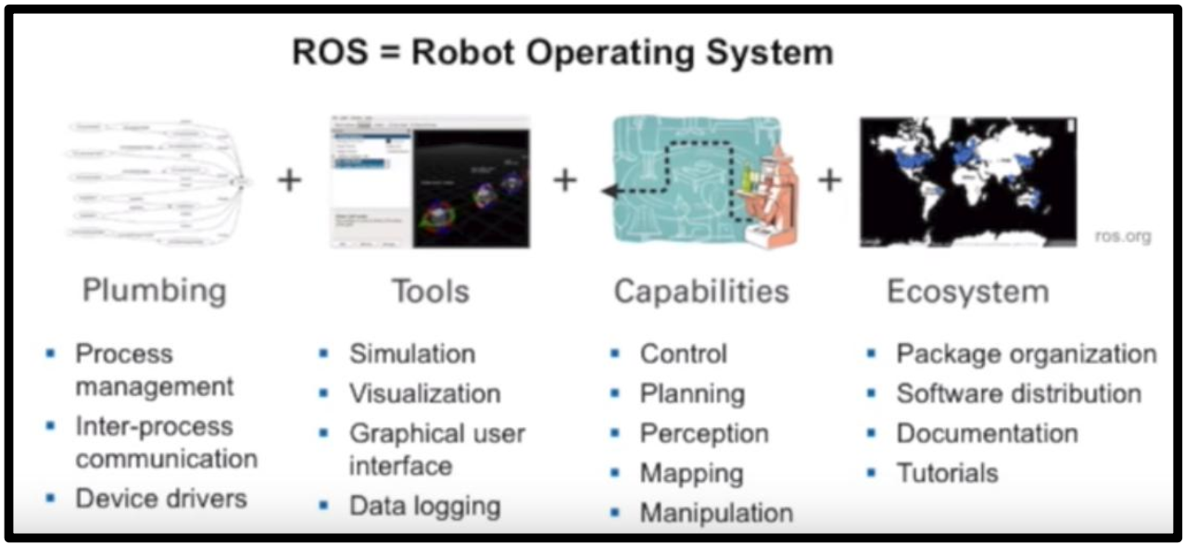
Implementation
Why ROS ?

